Slide 1
Cloud Security Foundations: Technologies, Posture, and Design Principles
Syed Aquib
Security Fundamentals For Cloud

Slide 2
CC ZG504, Cloud Security Foundations Lecture No.2

Slide 3
Agenda
Part 1: Cloud Security Technologies: The Alphabet Soup Demystified (30 minutes)
Introduction to Cloud Security Technologies
Cloud Security Posture Management (CSPM)
Cloud Workload Protection Platforms (CWPP)
Cloud-Native Application Protection Platforms (CNAPP)
Cloud Access Security Brokers (CASB)
Part 2: Cloud Security Posture Management and Threat Modeling (30 minutes)
Cloud Security Posture Management (CSPM) in Depth
Threat Modeling: Proactive Defense
Practical Threat Modeling Techniques
Part 3: Cloud Security Design Principles (30 minutes)
Secure by Design
Best Practices for Cloud Security Design
Q&A and Group Activity (30 minutes)

Slide 4
Session 1:
A Quick Recap
Navigating the Cloud Security Landscape
Key Points:
Shared Responsibility: Cloud security is a partnership between providers (security of the cloud) and customers (security in the cloud).
Rising Threats: Data breaches, malware, ransomware, and misconfigurations pose significant risks.
Real-World Impact: High-profile breaches like Capital One, Tesla, and Accenture underscore the need for vigilance.
Compliance Matters: GDPR, CCPA, HIPAA, and PCI DSS compliance are non-negotiable.
Deep Dive into Cloud Security Threats
Key Threats & Mitigation:
Data Breaches: Implement strong access controls and encryption.
Malware/Ransomware: Use robust endpoint protection and backup solutions.
Account Hijacking: Enforce strong password policies and multi-factor authentication.
Misconfigurations: Regularly audit and review cloud configurations.
Insider Threats: Implement least privilege access and monitor user activity.

Slide 5
Session 1:
A Quick Recap
Additional Considerations
Data Protection Regulations: GDPR, CCPA, HIPAA
Industry Standards: PCI DSS
Contractual Agreements: SLAs, DPAs
Jurisdiction and Data Sovereignty: Be aware of data storage location implications.
Cloud Computing Software Security Fundamentals
Software Assurance: Build secure software with dependability, trustworthiness, and survivability.
CIA Triad: Protect confidentiality, integrity, and availability of data.
Secure Development Practices: Follow secure coding guidelines and conduct thorough testing.
Risk Management: Identify, assess, and mitigate cloud computing risks.

Slide 6
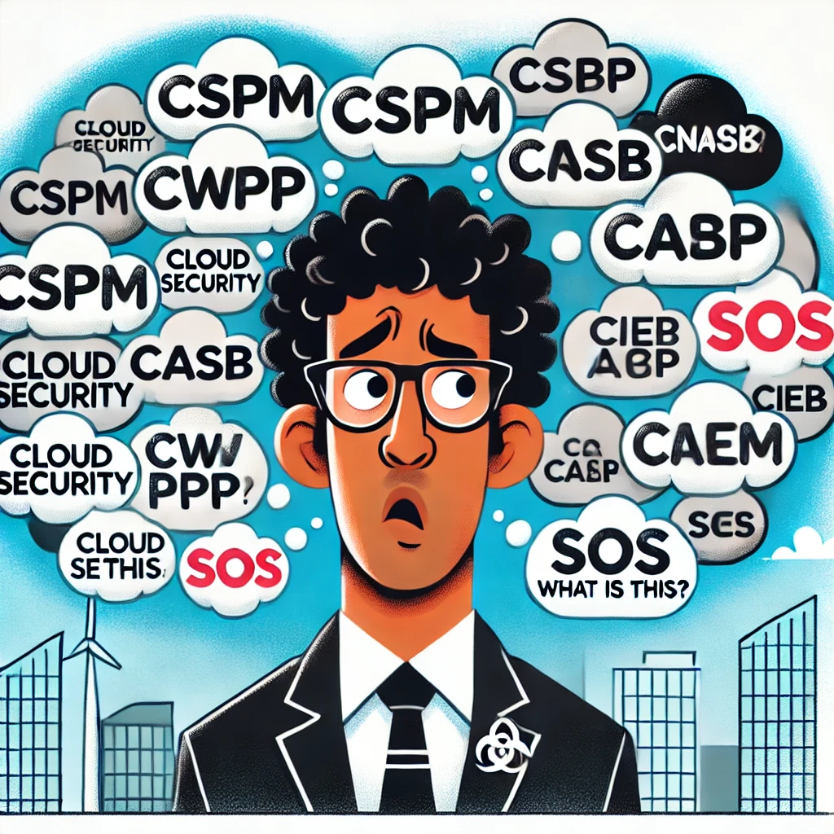

CSPM
CASB
CSPM, CWPP, CASB, C-WHAT now?
CWPP
C-WHAT?
Why These Acronyms Matter??
Research Guide
Vendor Language
Building Your Toolkit

Slide 7
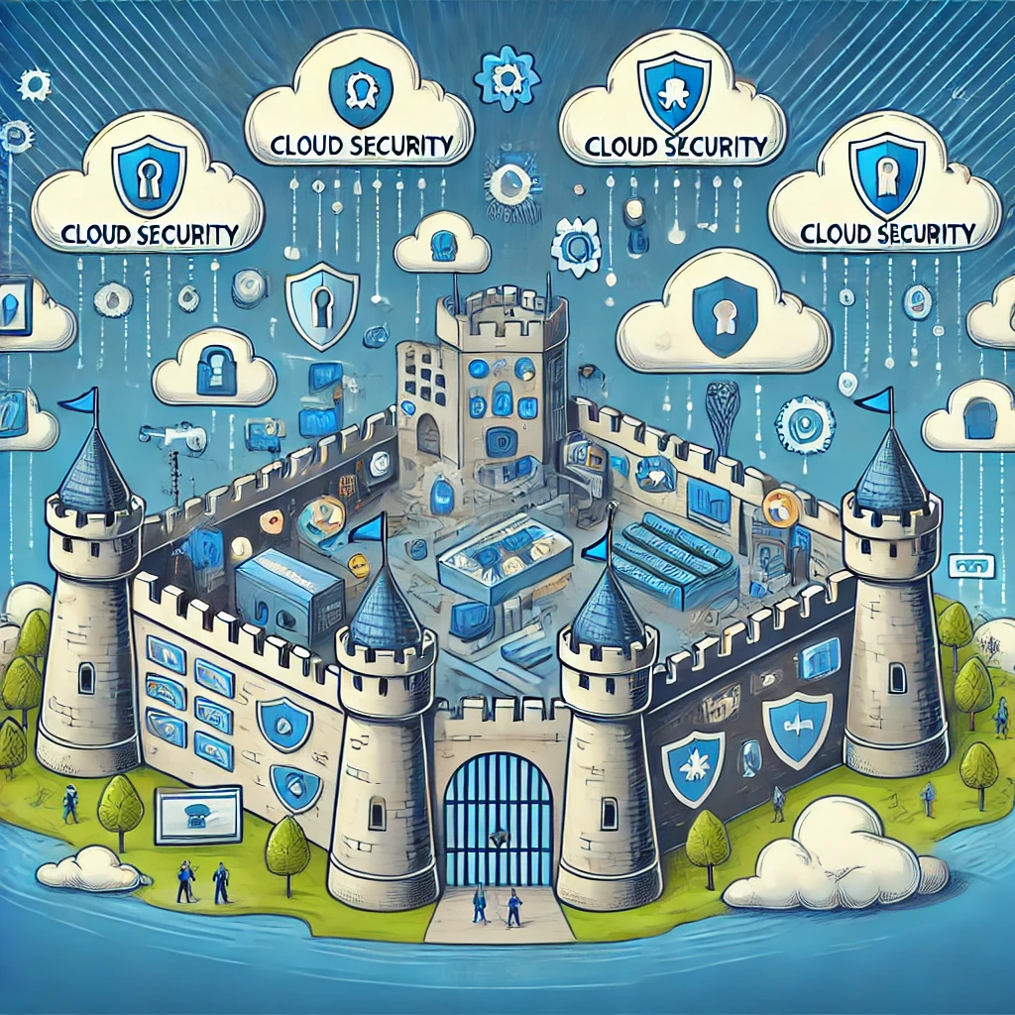
The Big Picture! Imagine you're building a fortress in the cloud. You need different tools and strategies to keep it safe.

Slide 8
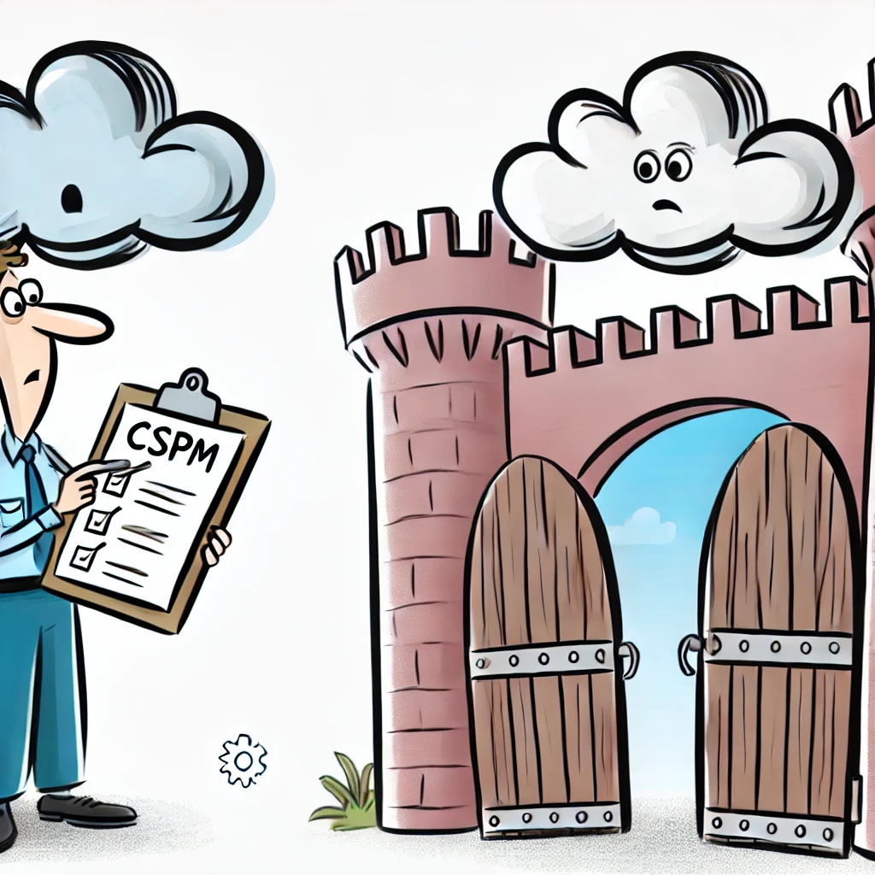
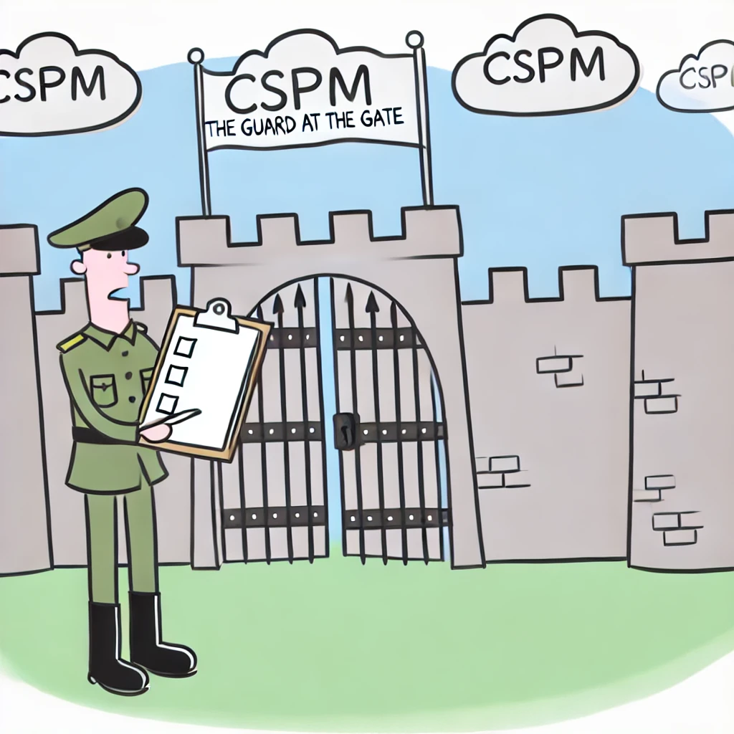
The Big Picture! Imagine you're building a fortress in the cloud. You need different tools and strategies to keep it safe.
Cloud Security Posture Management (CSPM)

Slide 9
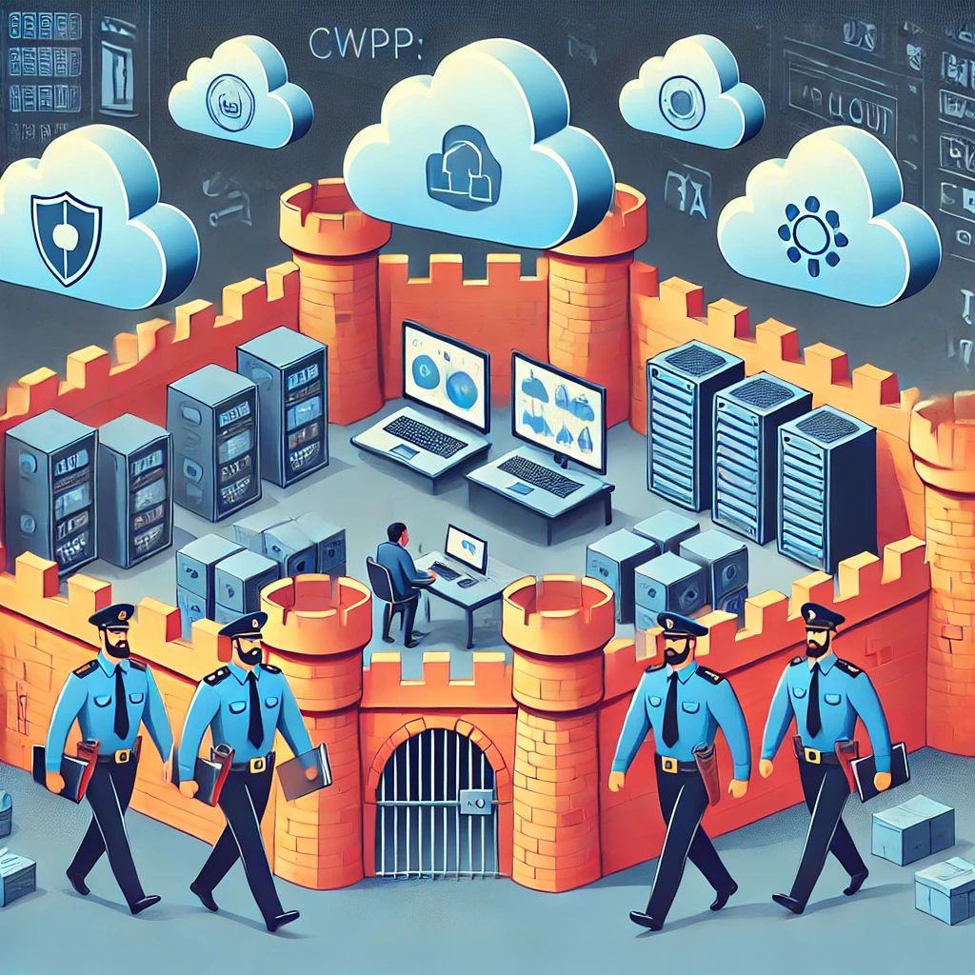
The Big Picture! Imagine you're building a fortress in the cloud. You need different tools and strategies to keep it safe.
Cloud Workload Protection Platforms (CWPP)

Slide 10
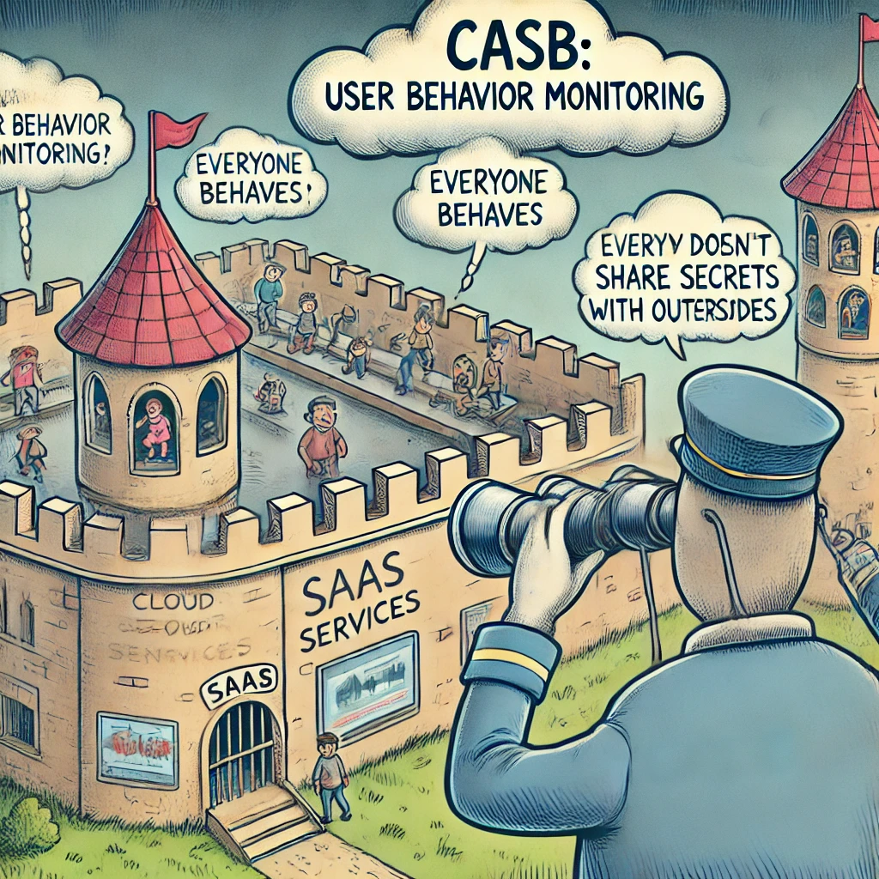
The Big Picture! Imagine you're building a fortress in the cloud. You need different tools and strategies to keep it safe.
Cloud Access Security Brokers (CASB)

Slide 11
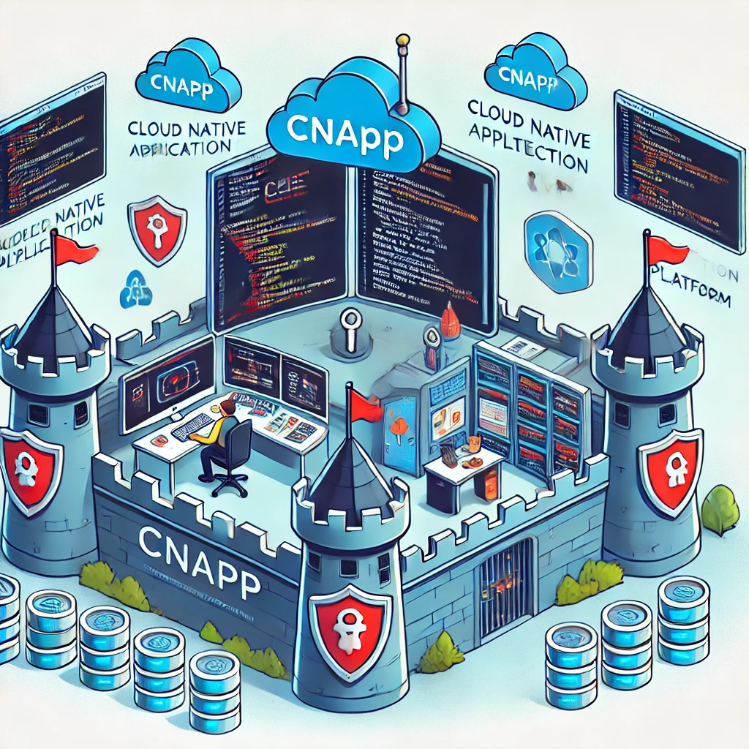
The Big Picture! Imagine you're building a fortress in the cloud. You need different tools and strategies to keep it safe.
Cloud-Native Application Protection Platforms (CNAPP)

Slide 12
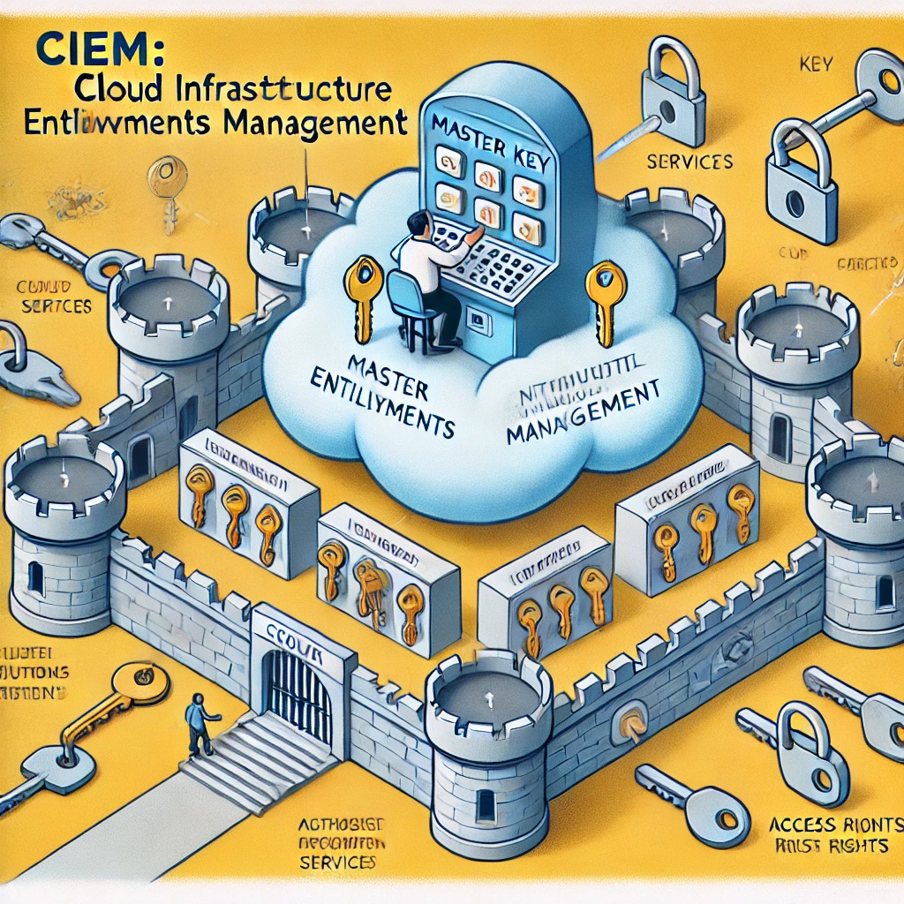
The Big Picture! Imagine you're building a fortress in the cloud. You need different tools and strategies to keep it safe.
Cloud Infrastructure Entitlements Management (CIEM)

Slide 13
How did we get here?
The Cloud Security Odyssey: A Journey Through Time
Late 2000s: The Cloud Takes Flight! ☁️🚀
Companies start moving to the cloud, leaving behind their old server rooms.
Cloud security becomes a top priority.
2010: CWPP Arrives! 🛡️💻
Gartner coins the term "Cloud Workload Protection Platform" (CWPP).
CWPPs help protect virtual machines and containers (the building blocks of cloud apps).
2014: CSPM Joins the Party! 👮‍♂️🔒
Cloud service providers (AWS, Azure, Google Cloud) are booming.
Gartner defines "Cloud Security Posture Management" (CSPM) to help keep cloud infrastructure secure.
2018: CIEM Steps In! 🔑👤
Cloud gets even more complex, leading to identity and access challenges.
"Cloud Infrastructure Entitlements Management" (CIEM) emerges to manage who gets access to what.
2020: CNAPP: The All-Star Team! 🦸‍♂️💥
Cloud-native technologies (like Kubernetes) are all the rage.
"Cloud Native Application Protection Platform" (CNAPP) combines the best of CSPM, CWPP, and more to provide comprehensive protection.
2024 and Beyond: The Journey Continues... 🚀🌌
Cloud security is still evolving rapidly, with new threats and technologies emerging.
Stay tuned for the next chapter in the Cloud Security Odyssey!

Slide 14
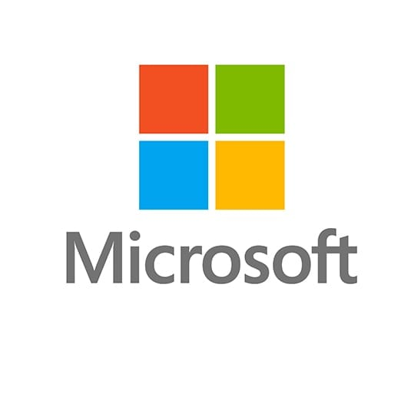
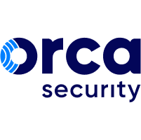
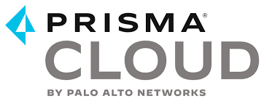

CSPM
(Cloud Security Posture Management)
What: A security tool that helps you assess, monitor, and improve the security posture of your cloud infrastructure. Think of it as a health check for your cloud environment.
How: CSPM tools continuously scan your cloud configuration and compare it against security best practices, industry standards, or your own customized policies. They identify misconfigurations, vulnerabilities, and compliance violations.
When: CSPM emerged around 2014 as organizations increasingly adopted cloud services and needed help managing the complexity of cloud security. Gartner formally defined the category in 2014.
Why: CSPM tools are essential for several reasons:
Risk Identification: They proactively identify security risks in your cloud environment before they can be exploited.
Compliance: They help you ensure that your cloud configuration adheres to regulatory requirements and industry standards.
Cost Optimization: They can help you optimize your cloud resources by identifying unused or over-provisioned assets.
Where: CSPM tools are deployed in the cloud environment itself, typically as SaaS solutions. They integrate with various cloud platforms like AWS, Azure, and Google Cloud to monitor and secure your cloud infrastructure.

Slide 15

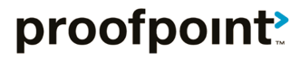
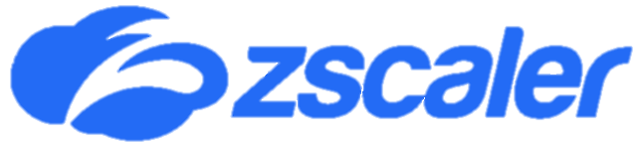
CASB
(Cloud Access Security Broker)
What: A security tool that acts as a middleman between your organization's users and cloud-based applications (SaaS). It's like a security checkpoint at the entrance to the cloud app.
How: CASB connects to cloud apps through APIs or proxies. It monitors user activity, enforces security policies, scans for sensitive data, and prevents data loss.
When: CASB emerged around 2012-2013 as organizations increasingly adopted cloud-based applications like Office 365, Salesforce, and Dropbox.
Why: CASBs are crucial for several reasons:
Visibility: They provide insight into how users interact with cloud apps and what data they access.
Data Security: They help protect sensitive data from unauthorized access, leakage, or misuse.
Compliance: They help organizations comply with data protection regulations like GDPR or HIPAA.
Threat Protection: They can detect and block malicious activity, such as malware or phishing attempts, within cloud apps.
Where: CASBs are deployed in the cloud, typically as a SaaS offering themselves. They sit between your users and the cloud apps they access, regardless of where the users are located.

Slide 16
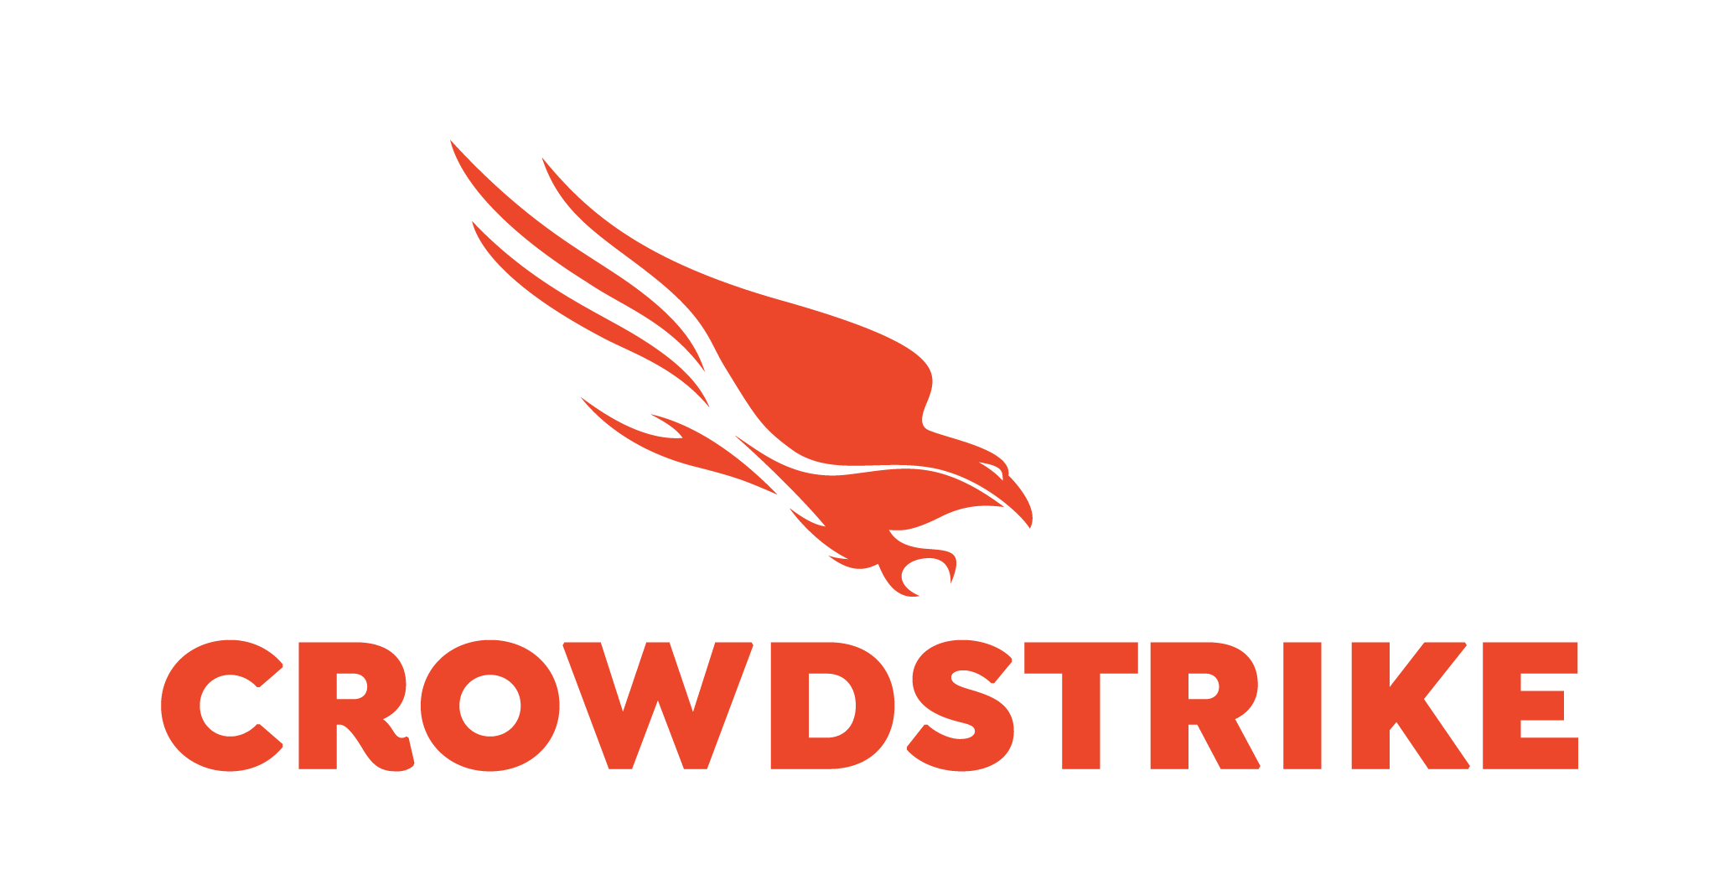
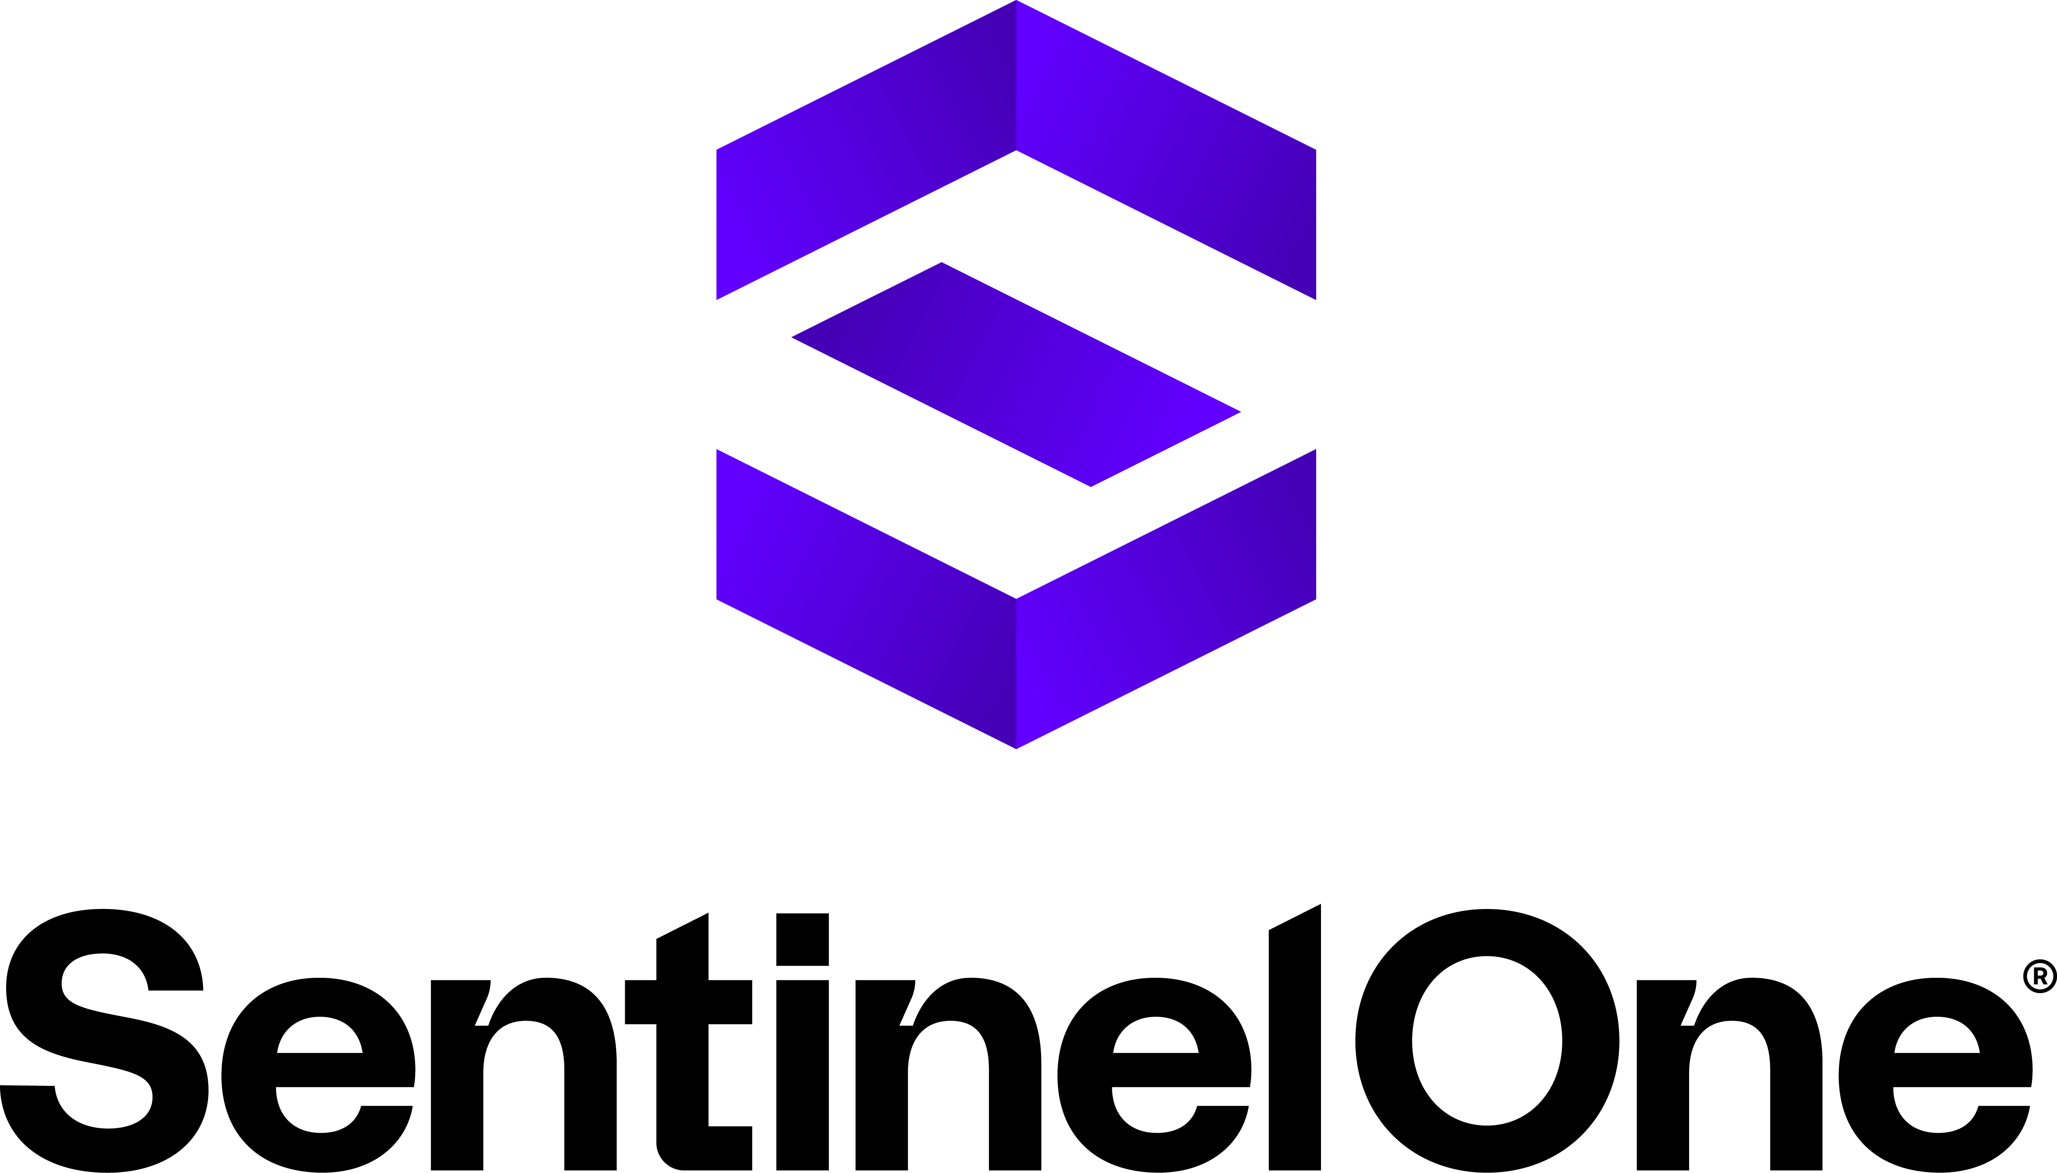
CWPP
(Cloud Workload Protection Platform)
What: A security tool that protects the workloads (applications and data) running in your cloud environment. It's like a security blanket wrapped around your cloud applications.
How: CWPPs work by using agents or sensors to monitor and secure the workloads running on virtual machines or containers. These tools can detect and block threats, identify vulnerabilities, and enforce security policies.
When: CWPP emerged in the late 2000s as cloud computing and virtualization became more prevalent. Gartner formally defined the category in 2010.
Why: CWPPs are essential for several reasons:
Runtime Protection: They offer continuous monitoring and protection for cloud workloads against attacks like malware, intrusions, and exploits.
Vulnerability Management: They can identify vulnerabilities in your workloads and help you prioritize remediation efforts.
Compliance: They help you meet regulatory requirements by ensuring your cloud workloads adhere to security standards.
Where: CWPPs are deployed in the cloud environment itself, protecting the workloads running on various cloud platforms like AWS, Azure, or Google Cloud. They can also be used in hybrid cloud environments, where some workloads run on-premises and others in the cloud.

Slide 17
CNAPP
(Cloud Native Application Protection Platform)
What: A comprehensive security platform that protects cloud-native applications throughout their lifecycle, from development to runtime. It's like a security shield that covers your entire cloud-native app ecosystem.
How: CNAPP combines various security capabilities, including:
Code Security: Scanning code for vulnerabilities during development.
Infrastructure Security: Assessing the security posture of your cloud infrastructure (like CSPM).
Workload Security: Protecting running applications and data (like CWPP).
Runtime Security: Monitoring for threats and attacks in real-time.
When: CNAPP emerged as a formal category around 2020, driven by the increasing adoption of cloud-native technologies like containers, Kubernetes, and microservices.
Why: CNAPPs offer several advantages:
Unified Security: They provide a single platform for managing security across the entire cloud-native stack.
DevSecOps Integration: They seamlessly integrate into the development and deployment workflows, promoting a "shift left" security approach.
Comprehensive Protection: They address a wider range of threats and vulnerabilities compared to traditional cloud security tools.
Where: CNAPPs are deployed in cloud environments that host cloud-native applications. They can run on various cloud platforms or be offered as SaaS solutions.

Slide 18

CIEM
(Cloud Infrastructure Entitlements Management)
What: A security tool that helps manage and govern access permissions (entitlements) within your cloud infrastructure. Think of it as the bouncer at a nightclub, ensuring only the right people get in and have access to the right areas.
How: CIEM tools continuously monitor the permissions and access rights assigned to users, roles, services, and resources in your cloud environment. They analyze these entitlements, identify risks like excessive permissions or toxic combinations, and enforce least privilege principles.
When: CIEM emerged around 2018 as cloud environments grew in complexity, making it challenging to manage the vast number of identities and permissions.
Why: CIEM is crucial for several reasons:
Risk Reduction: It helps minimize the risk of unauthorized access, data breaches, and privilege escalation by ensuring least privilege and identifying excessive permissions.
Compliance: It helps organizations meet regulatory requirements (like GDPR, HIPAA) by demonstrating proper access controls and governance.
Operational Efficiency: It automates the process of entitlement reviews and certifications, saving time and effort for security teams.
Where: CIEM tools are typically deployed as SaaS solutions, integrating with various cloud platforms like AWS, Azure, and Google Cloud. They can also be used in hybrid and multi-cloud environments.

Slide 19
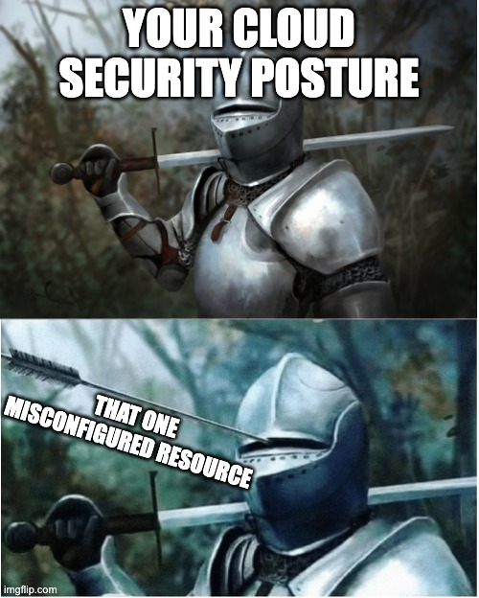
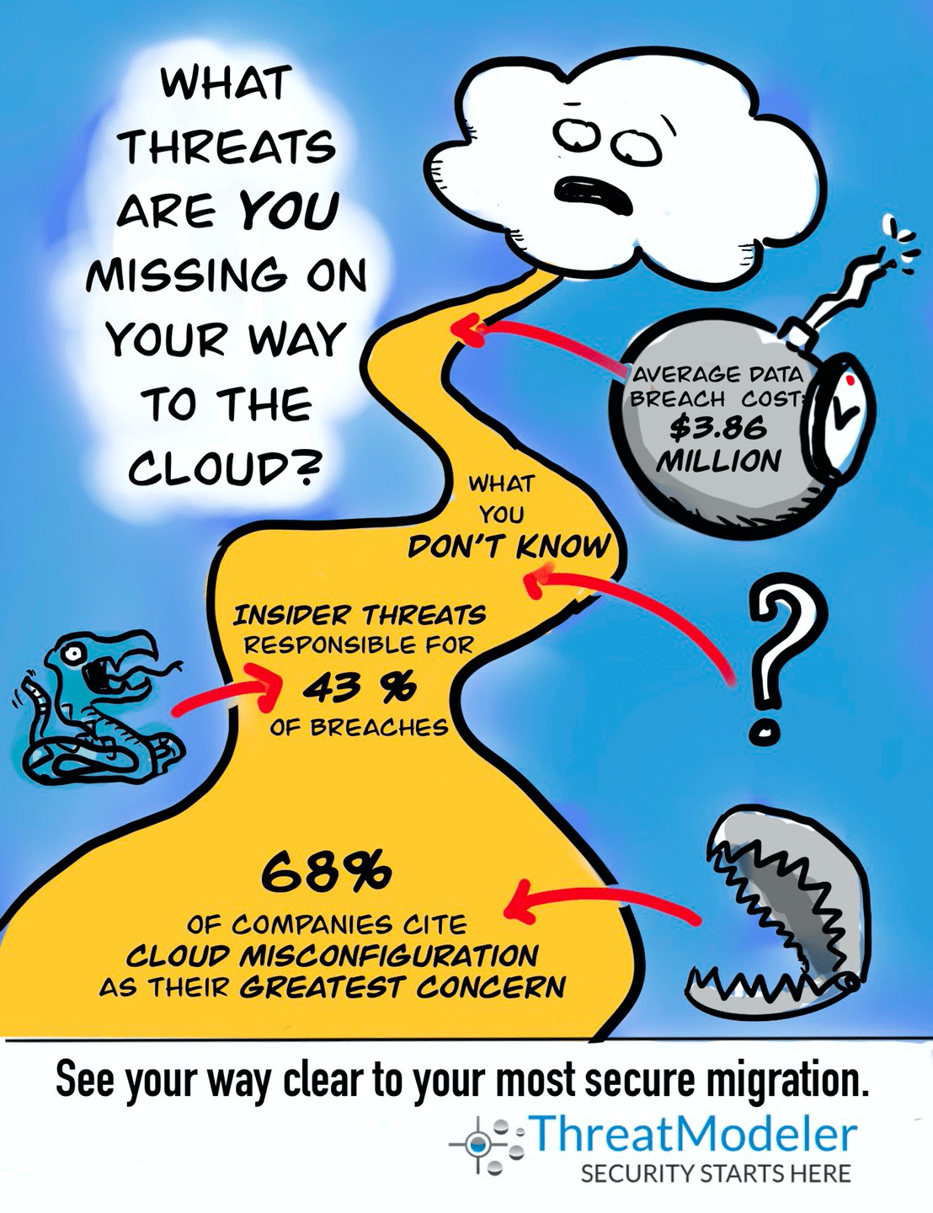
Part 2:
Cloud Security Posture Management and Threat Modeling
Image Credit: ThreatModeler

Slide 20
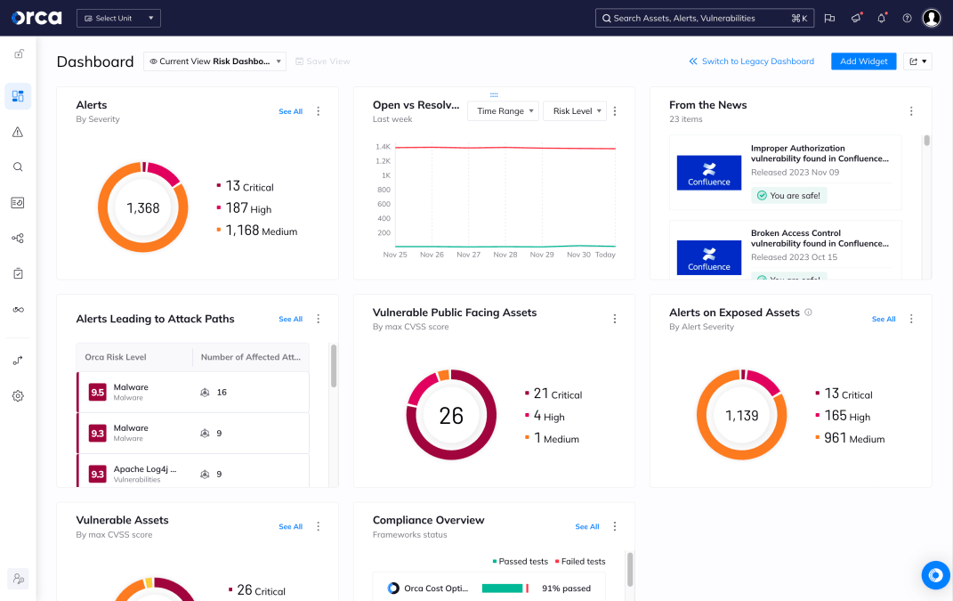
Cloud Security Posture Management (CSPM) in Depth - Continuous Monitoring: Your 24/7 Security Guard

Slide 21
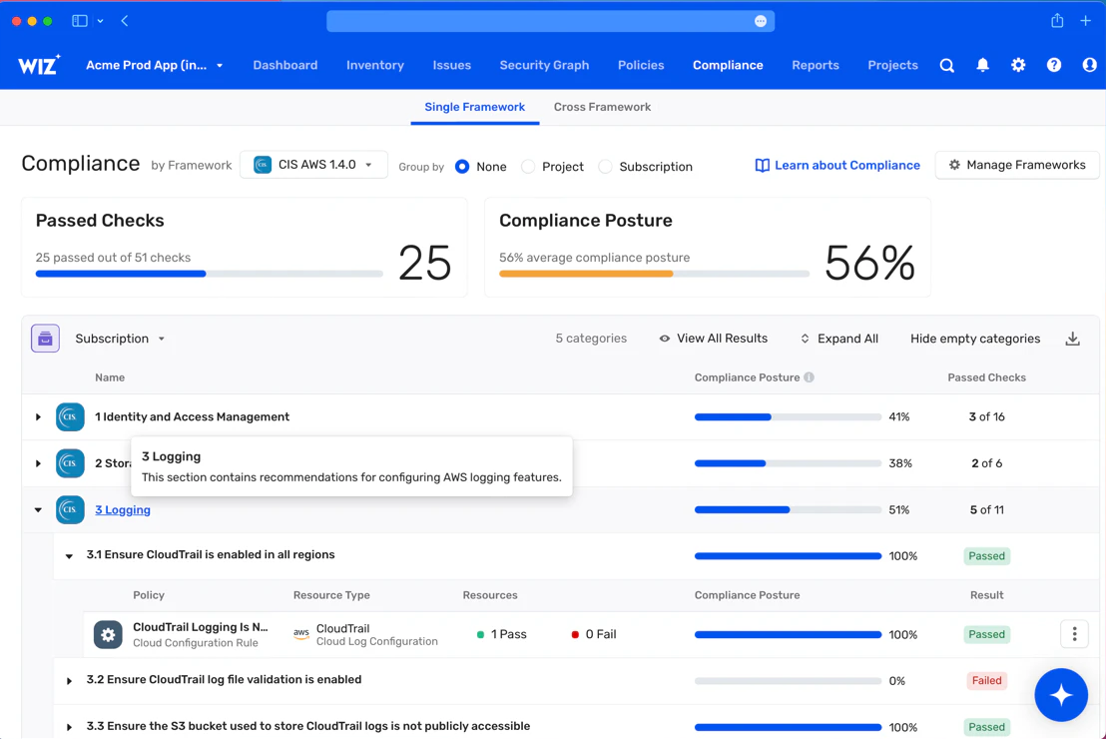
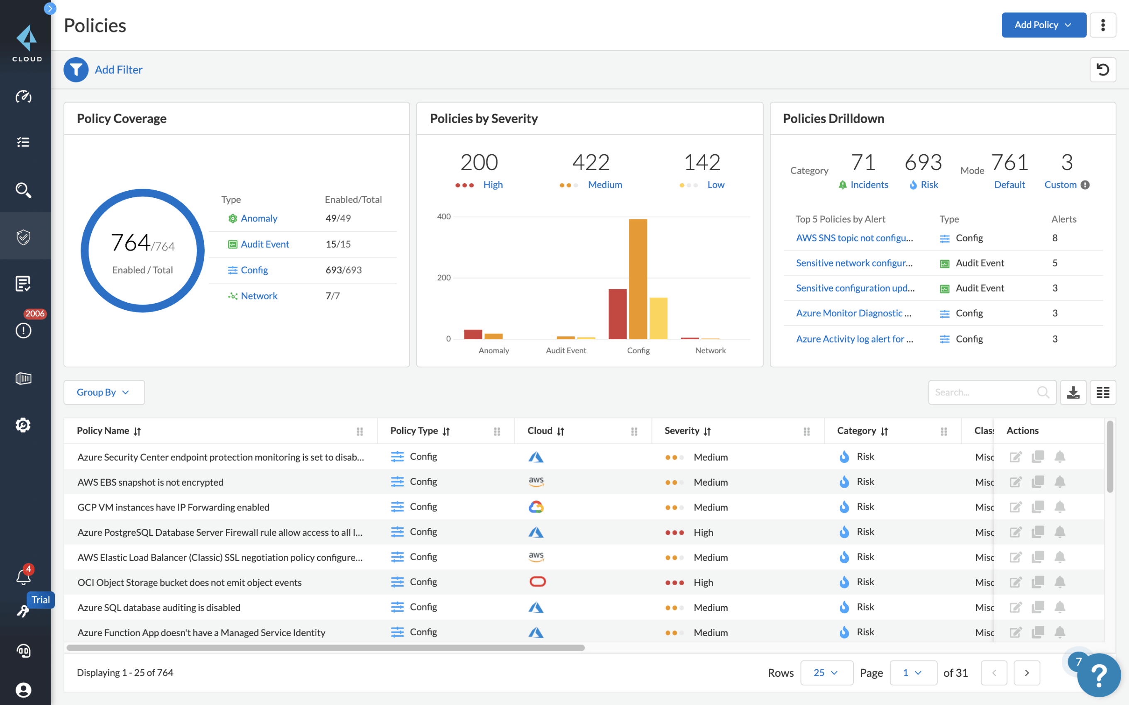
Cloud Security Posture Management (CSPM) in Depth - Compliance: Your Passport to Regulatory Confidence

Slide 22
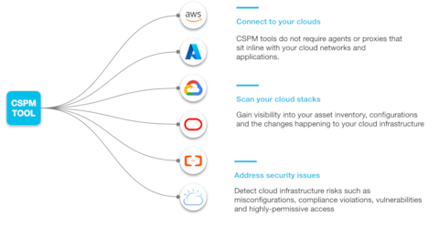
Cloud Security Posture Management (CSPM) in Depth - Integration: The Power of Teamwork

Slide 23
CSPM in Action:
Securing Your AWS Cloud
Example: S3 Bucket Misconfiguration
Detection: The CSPM tool detects that an S3 bucket containing sensitive data is publicly accessible due to a misconfigured bucket policy.
Alert: It sends an alert to your security team, highlighting the severity of the issue and providing details on the misconfiguration.
Remediation: The security team investigates the issue, modifies the bucket policy to restrict access, and verifies that the issue is resolved.
Monitoring: The CSPM tool continues to monitor the S3 bucket and other AWS resources, ensuring that the security posture remains intact.

Slide 24
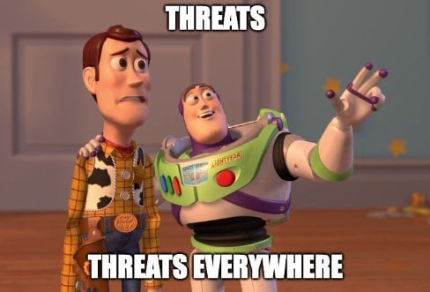
Threat Modeling: Proactive Defense

Slide 25





Slide 26
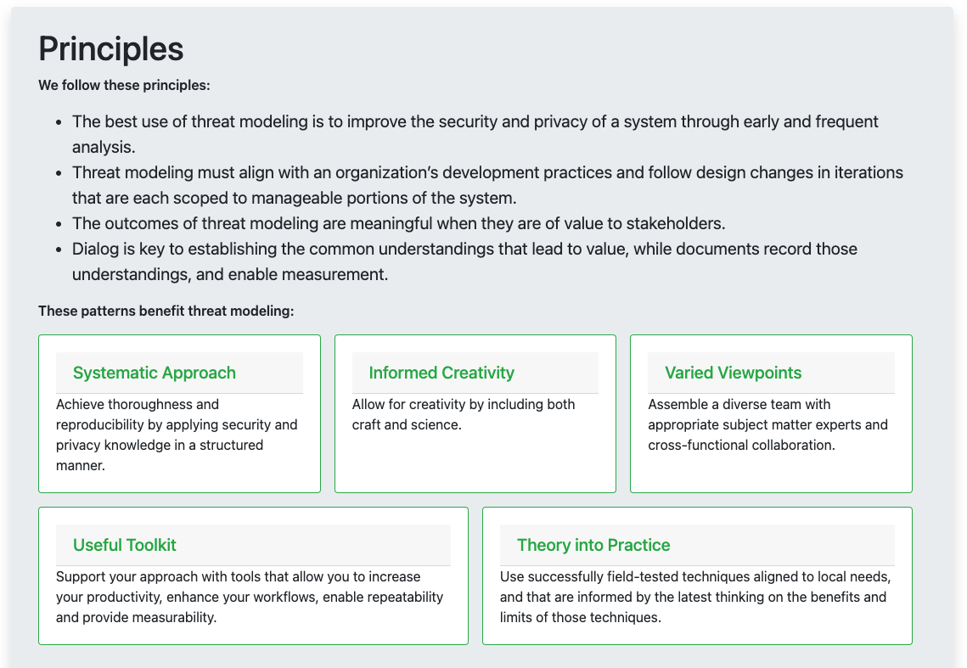
Threat Modeling Manifesto

Slide 27
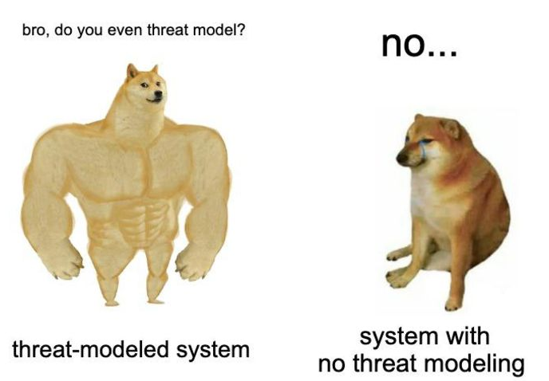
What is Threat Modeling?
Imagine you're a general preparing for battle. You need to anticipate your enemy's moves and plan your defenses accordingly. That's what threat modeling does for your cloud environment.
It's a structured process of identifying, analyzing, and prioritizing potential threats to your cloud assets (data, applications, infrastructure). It's like creating a map of your vulnerabilities and weaknesses so you can fortify them before attackers exploit them.

Slide 28
Why is Threat Modeling Important?
Proactive Defense: Threat modeling shifts your focus from reactive firefighting to proactive defense. You can identify and address vulnerabilities before they are exploited, reducing the risk of security breaches and data loss.
Informed Decision-Making: By understanding the potential threats, you can make informed decisions about security investments and prioritize remediation efforts based on the risks they pose.
Improved Security Posture: Regular threat modeling strengthens your overall security posture by continuously identifying and addressing new threats as they emerge.

Slide 29
Steps in Threat Modeling:
Asset Identification:
What are your most valuable assets in the cloud? (e.g., customer data, intellectual property, critical applications)
Where are these assets located? (e.g., specific cloud services, regions, data centers)
Threat Identification:
What are the potential threats to your assets? (e.g., data breaches, unauthorized access, denial of service attacks)
Who might be the adversaries? (e.g., hackers, insiders, competitors)
What are their motivations? (e.g., financial gain, espionage, disruption)
Vulnerability Analysis:
What are the weaknesses in your cloud environment that could be exploited by these threats? (e.g., misconfigurations, software vulnerabilities, weak access controls)
Risk Assessment:
What is the likelihood of each threat occurring?
What would be the impact if the threat was successful?
Based on the likelihood and impact, prioritize the risks that need to be addressed.
Remediation Planning:
Develop a plan to mitigate the identified risks. (e.g., implement security controls, patch vulnerabilities, strengthen access controls)

Slide 30
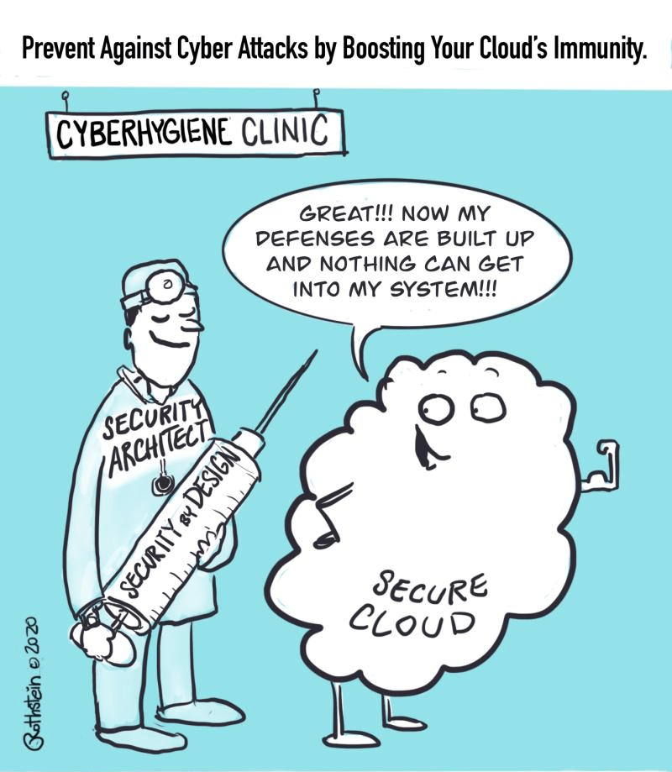
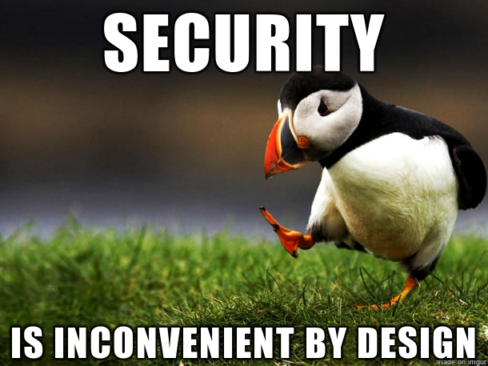
Part 3:
Cloud Security Design Principles
Image Credit: ThreatModeler

Slide 31

Secure by Design:
Building Security into Your Cloud DNA
Building Security into Your Cloud DNA

Slide 32
The Importance of Security in the Design Phase
Prevention is Better than Cure: Integrating security into the design phase helps prevent vulnerabilities from being baked into your cloud infrastructure. It's much easier and cheaper to address security issues early on than to try to fix them later.
Resilience by Design: Secure by design builds resilience into your cloud environment. Even if a security incident occurs, a well-designed architecture can help contain the damage and recover quickly.
Compliance from the Start: By incorporating security into the design, you can ensure that your cloud environment complies with regulatory requirements and industry standards from the outset.

Slide 33
Key Principles of Secure by Design
Least Privilege: Give users and systems only the minimum permissions they need to perform their tasks. This limits the potential damage if a compromise occurs.
Defense in Depth: Don't rely on a single layer of security. Implement multiple layers of defense to create a more robust security posture. Think of it like a castle with multiple walls and moats.
Zero Trust: Assume that no user or device can be trusted by default. Verify every access request, even from internal sources.
Immutable Infrastructure: Treat your infrastructure as immutable. Instead of updating existing resources, replace them with new, pre-configured ones. This reduces the risk of configuration drift and makes it easier to recover from incidents.

Slide 34
Secure by Design in Action: Consider an AWS environment
Least Privilege: Use IAM roles to grant granular permissions to EC2 instances instead of using root access.
Defense in Depth: Combine security groups, network ACLs, and AWS WAF to create multiple layers of network security.
Zero Trust: Implement multi-factor authentication (MFA) for all users and enforce strong password policies.
Immutable Infrastructure: Use infrastructure as code (IaC) tools like CloudFormation or Terraform to provision and manage your AWS resources.
By embracing these principles, you can create a cloud environment that is fundamentally secure, reducing the risk of security breaches and ensuring the confidentiality, integrity, and availability of your data and applications.

Slide 35
Group Activity – 10 mins Cloud Castle Defense: A Threat Modeling Game
Each team draws a simple diagram of a cloud environment in draw.io. This should include:
Assets: Key resources like data storage, servers, applications, etc.
Entry points: Ways that users or systems access the environment (e.g., web interfaces, APIs).
Threat Storming: Each team brainstorms potential threats to their cloud castle. These can be specific attacks (e.g., data breaches, malware, DDoS attacks) or broader categories (e.g., natural disasters, human error). Write each threat on a red sticky note and place it near the relevant asset or entry point.
Vulnerability Assessment: For each threat, identify potential vulnerabilities in your cloud castle that could be exploited. These could be technical weaknesses (e.g., unpatched software, misconfigurations), operational issues (e.g., lack of access controls, inadequate backups), or even human factors (e.g., social engineering, insider threats). Write each vulnerability on a yellow sticky note and link it to the relevant threat.
Risk Ranking: As a team, discuss and prioritize the risks based on their likelihood and potential impact. Use a simple scale like Low, Medium, High, or Critical.
Mitigation Strategies: For each high-priority risk, brainstorm mitigation strategies. These could be technical controls (e.g., firewalls, encryption, intrusion detection), operational processes (e.g., access reviews, incident response plans), or user education (e.g., security awareness training).
Present and Discuss: Each team presents their cloud castle, identified threats and vulnerabilities, risk ranking, and mitigation strategies to the larger group. Encourage discussion and feedback.

Slide 36

Thank you

